Slide 1
Chapter 13
Solver .out File and CCL
Introduction to CFX

Slide 2
Solver Output File
Produced by the ANSYS CFX-Solver and contains information about your simulation:
  a) Model set-up
  b) The state of the solution during the run
  c) Job statistics for the particular run
Now lets take a detailed look at an out file…
.cfx, .def, .res
CFX-Pre
.cfx
.def
CFX-Solver
.out
.res
.gtm, .def
CFX-Post

Slide 3
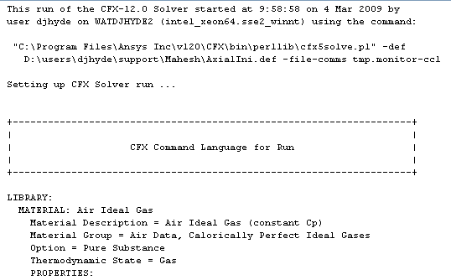
a) Model Setup
Solver Information
The out file

Slide 4
a) Model Setup
Physics definition
CFX Command Language (CCL)

Slide 5

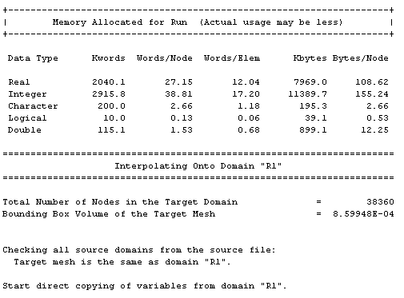
b) Interpolator
If an Initial Values file is provided, the Interpolator will run to copy / interpolate variables
…
…
Memory requirements shown here are for the interpolator only
Details of the interpolation process are shown
…
…

Slide 6
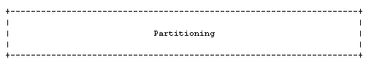
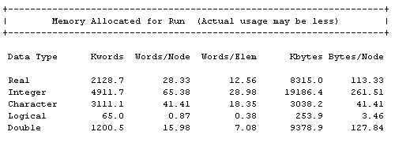
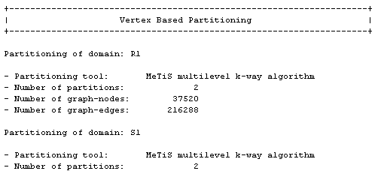
c) Partitioner
If solving in parallel the Partitioner will run to divide up the simulation into multiple partitions
…
…
Memory requirements shown here are for the partitioner only
…
…
Details of the partitioning process are shown

Slide 7

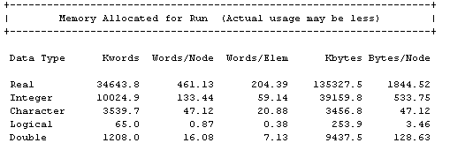
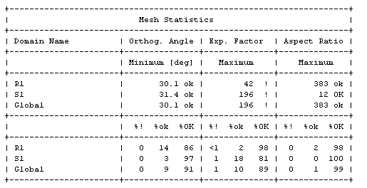
d) Solver
The start of the Solver process
…
…
Memory requirements shown here are for the Solver. If memory errors occur check if it’s the Interpolator, Partitioner or Solver process
…
…
188 MB of RAM allocated
Mesh quality checks, mesh statistics and GGI intersection details are shown here

Slide 8
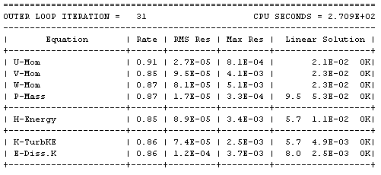

e) The State of the Solution
Diagnostics shown as the solver iterates towards a solution
Upper case “OK” is good. Lower case “ok” means you’re on the limit. “F” means failed to solve the equation. Reducing the timestep may help avoid “ok” and “F”. The first few iterations may show “ok” and “F” and can be ignored as long as they go away
Notes:
The first column is the average number of iterations the linear solvers attempted to obtain the specified linear equation convergence criteria (within a specified number of iterations). The second column gives the normalized residuals for the solutions to the linear equation. The last column can have one of four entries:
* indicates that there was a numerical floating point exception and this resulted in the failure of the linear solvers.
F indicates that the linear solvers did not reduce the residuals (i.e., the solution was diverging), but the linear solvers may carry on if the divergence is not catastrophic.
ok indicates that the residuals were reduced, but that the degree of reduction did not meet the specified criteria.
OK indicates that the specified convergence criteria for the reduction of residuals was achieved.

Slide 9
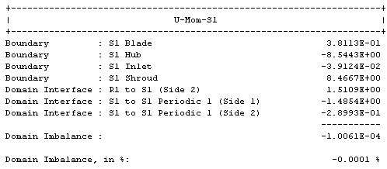
f) Final Imbalances
When the solution finishes the Imbalances are shown
Equation Imbalance in domain

Slide 10
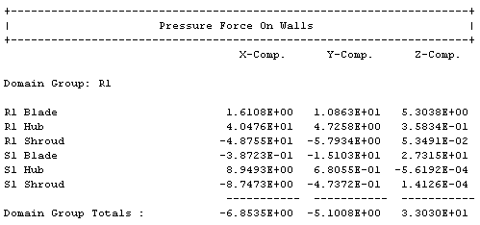
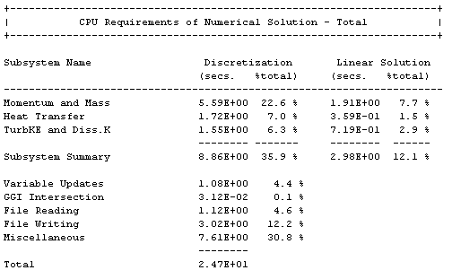
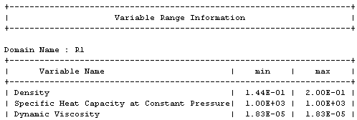
g) Other Solution Data
Other data printed at the end of the out file include Viscous and Pressure forces and torques on walls, min / max variable values and detailed CPU requirements

Slide 11
Key Point
The .out file contains information on the physics, solution progress, and execution control.

Slide 12
What is CCL?
CFX Command Language
  object definition language which underlies all CFX products
  Object parameters define the “state” of an object
  GUIs present object parameters in a contextual manner (parameters shown/hidden based on GUI selections)
Allows for easy modifications
  E.g. modifying an inlet velocity at a boundary
Advanced functionality (without complexity)
  i.e. loops and logic
User Input/Interface
CCL
CCL Command
Interpreter
Processing Engine

Slide 13
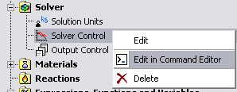

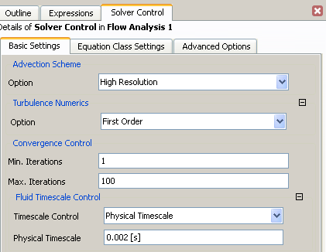
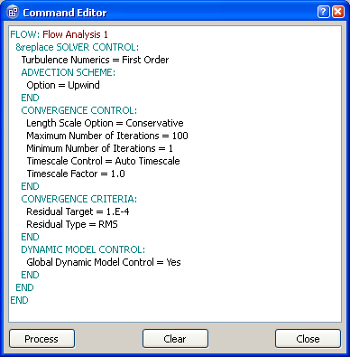
CCL Instruction Types
CCL Statements can be classified into three categories:
    Object and parameter definitions
    Actions
    Power Syntax
1. Example of Parameter Definition:

Slide 14
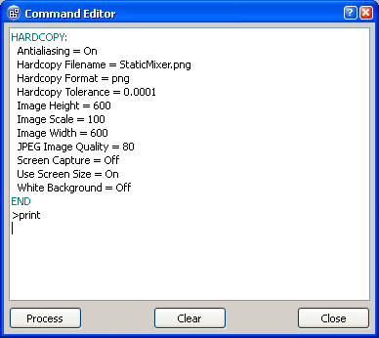
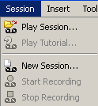
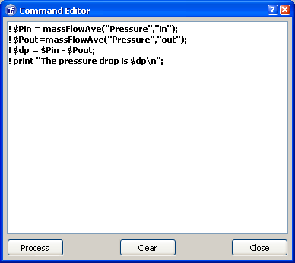
CCL Instruction Types
2. Example of an Action Command:
A CFX-Post session file which includes a set of actions.
3. Example of Power Syntax:
Lines of Power Syntax are identified in a
CCL file by a special character “!” at the
start of each line.

Slide 15
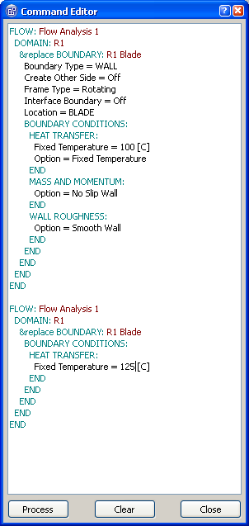
Data Hierarchy
Terminology: The object Flow is the parent of the object Domain, and this is Flow Analysis 1
Terminology: Parameter Name = Parameter Value
As long as the parameters are of the same object, order is unimportant
An object started must be ended
CCL follows a data hierarchy. In order to specify the Temperature, the associated parents (Boundary, Domain, Flow) must be included
If data is set in one place and modified in another, the latter definition overrides the first

Slide 16
Syntax
The syntax rules of CCL are similar to many programming languages. Below are a few syntax rules but for a complete list, please search the help documentation (CCL Syntax)
  Case Sensitivity
    Everything in the file is sensitive to case.
  Effect of spaces
    Spaces appearing before or after a name are not considered to be part of the name.
    Single spaces appearing inside a name are significant.
    Multiple spaces and tabs appearing inside a name are treated as a single space.
  CCL names definition
    In simple syntax, a CCL name must be at least one character.
    This first character must be alphabetic; there may be any number of subsequent characters and these can be alphabetic, numeric, space or tab.
  Continued on next slide…
Notes:
CASE SENSITIVITY
Everything in the file is sensitive to case.
EFFECT OF SPACES
Spaces appearing before or after a name are not considered to be part of the name.
Single spaces appearing inside a name are significant.
Multiple spaces and tabs appearing inside a name are treated as a single space.
CCL NAMES DEFINITION
In simple syntax, a CCL name must be at least one character.
This first character must be alphabetic; there may be any number of subsequent characters and these can be alphabetic, numeric, space or tab.
PARAMETER VALUES
STRING
The characters $ and # have a special meaning. A string beginning with $ is evaluated as a Power Syntax variable, even if it occurs within a simple syntax statement.
The characters such as [, ],{ and } are special only if used in conjunction with $. Following a $, such characters terminate the preceding Perl variable name
STRING LIST
A list of string items separated by commas.
e.g names = one, two, three, four
INTEGER
If a real is specified when an integer is needed, the real is rounded to the nearest integer.
REAL
a = 12.24
a = 1.224E01
a = 12.24 [m s^-1]
REAL LIST
All items in the list must have the same dimensions
LOGICAL
Several forms are acceptable: YES, TRUE, 1 or ON are all equivalent; NO or FALSE or 0 or OFF are all equivalent; initial letter variants Y, T, N, F are accepted

Slide 17
Syntax
  Parameter Values
    STRING
      The characters $ and # have a special meaning. A string beginning with $ is evaluated as a Power Syntax variable, even if it occurs within a simple syntax statement.
      The characters such as [, ],{ and } are special only if used in conjunction with $. Following a $, such characters terminate the preceding Perl variable name
    STRING LIST
      A list of string items separated by commas.
      e.g names = one, two, three, four
    INTEGER
      If a real is specified when an integer is needed, the real is rounded to the nearest integer.
    REAL
    a = 12.24
    a = 1.224E01
    a = 12.24 [m s^-1]
    REAL LIST
      All items in the list must have the same dimensions
    LOGICAL
      Several forms are acceptable: YES, TRUE, 1 or ON are all equivalent; NO or FALSE or 0 or OFF are all equivalent; initial letter variants Y, T, N, F are accepted
  Continuation character \
Notes:
CASE SENSITIVITY
Everything in the file is sensitive to case.
EFFECT OF SPACES
Spaces appearing before or after a name are not considered to be part of the name.
Single spaces appearing inside a name are significant.
Multiple spaces and tabs appearing inside a name are treated as a single space.
CCL NAMES DEFINITION
In simple syntax, a CCL name must be at least one character.
This first character must be alphabetic; there may be any number of subsequent characters and these can be alphabetic, numeric, space or tab.
PARAMETER VALUES
STRING
The characters $ and # have a special meaning. A string beginning with $ is evaluated as a Power Syntax variable, even if it occurs within a simple syntax statement.
The characters such as [, ],{ and } are special only if used in conjunction with $. Following a $, such characters terminate the preceding Perl variable name
STRING LIST
A list of string items separated by commas.
e.g names = one, two, three, four
INTEGER
If a real is specified when an integer is needed, the real is rounded to the nearest integer.
REAL
a = 12.24
a = 1.224E01
a = 12.24 [m s^-1]
REAL LIST
All items in the list must have the same dimensions
LOGICAL
Several forms are acceptable: YES, TRUE, 1 or ON are all equivalent; NO or FALSE or 0 or OFF are all equivalent; initial letter variants Y, T, N, F are accepted

Slide 18
CCL Examples
CCL is used throughout CFX and other CFX products, a few examples are:
  CFX-Pre: Physics definition, Session Files
  CFX-Solve: Command File (echoed in the OUT file)
  CFX-Post : State files, Session Files
  CFX-TurboGrid: State Files

Slide 19
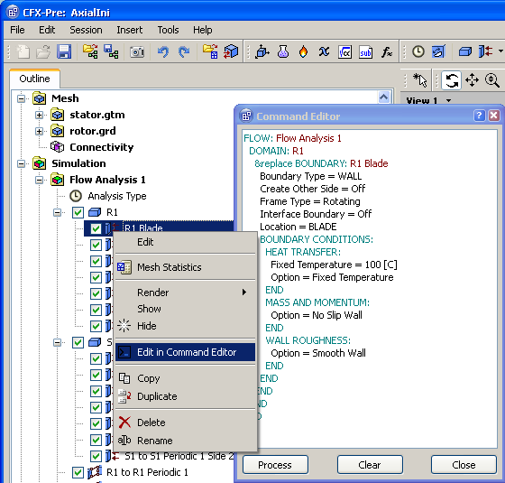
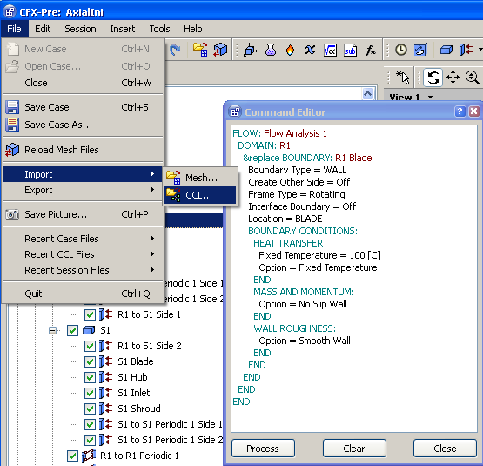
CFX-Pre

Slide 20
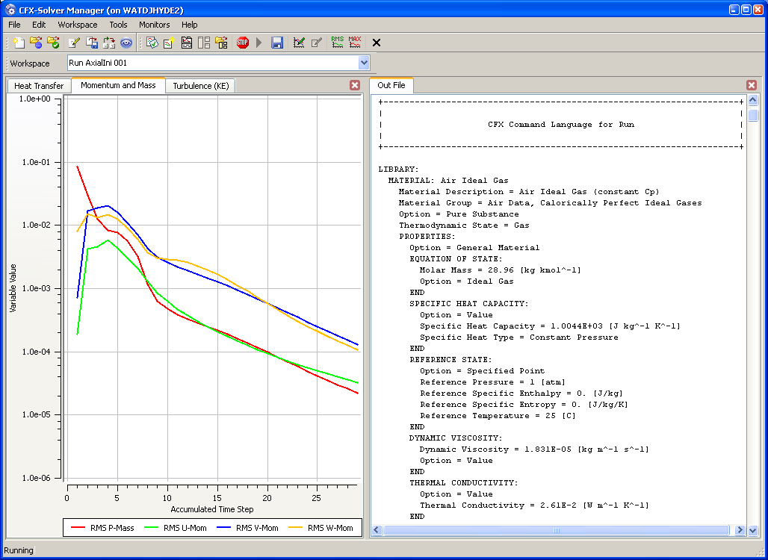
CFX-Solver / .out File

Slide 21
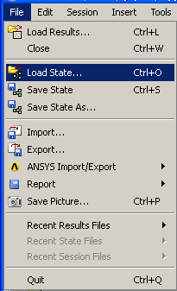
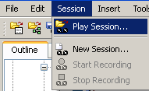
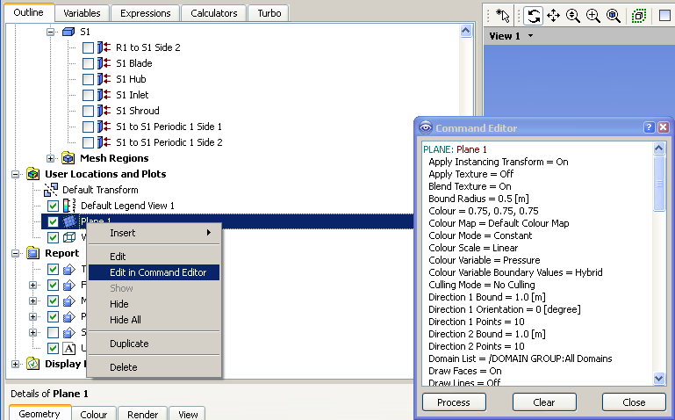
CFD-Post

Slide 22
Quick Modifications
Users can modify a .def file manually using CCL instead of using the CFX-Pre GUI
Two alternate methods of modifying a DEF file:
    Solver GUI
    Command Lines
CFX Pre
Reload .CFX or .DEF file
Modify Settings
DEF
CFX Solver
RES

Slide 23

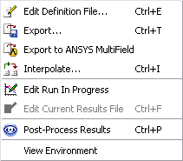
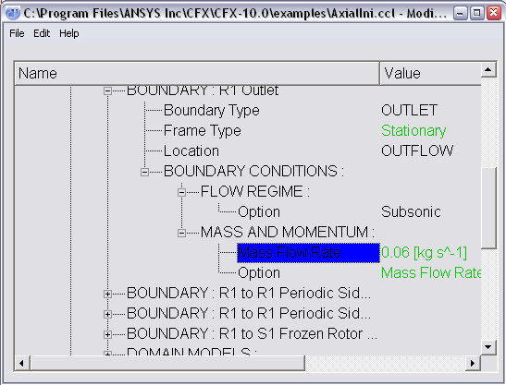
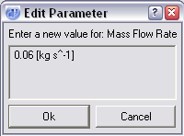
Quick Modifications
SOLVER METHOD
Modify Settings
DEF
CFX Solver
RES

Slide 24
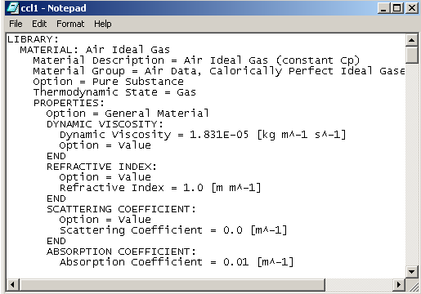
Quick Modifications
COMMAND LINE METHOD
In the CFX-Launcher window, click “Tools > Command Line”
In command screen type → cfx5cmds –read –def filename.def –text ccl1
Edit ccl1 in notepad and save
In command screen type → cfx5cmds –write –def filename.def –text ccl1
Modify Settings
DEF
CFX Solver
RES

Slide 25
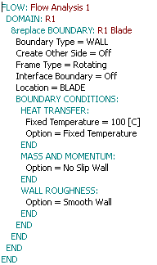
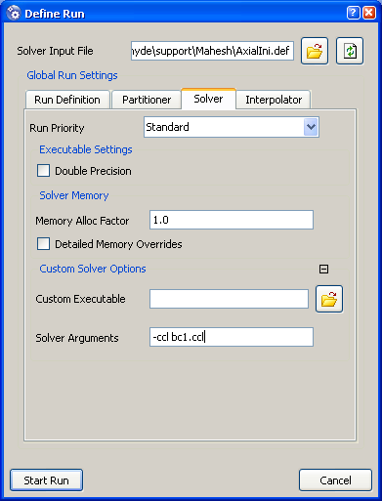
Quick Modifications
Using a CCL file
  Create a text file with modified CCL
  “Save As” .ccl file, (e.g. “bc1.ccl”)
  On the Solver tab of the Run Definition form in the Solver manager, enter an Argument as follows:
    -ccl bc1.ccl
  Or, start the solution from the command line, using:
    cfx5solve –def run.def –ccl bc1.ccl

Slide 26
Key Point
CCL is the language which links the user with the software. Sometimes, it is more efficient to bypass the GUI and manipulate the CCL manually.

